Slide 1
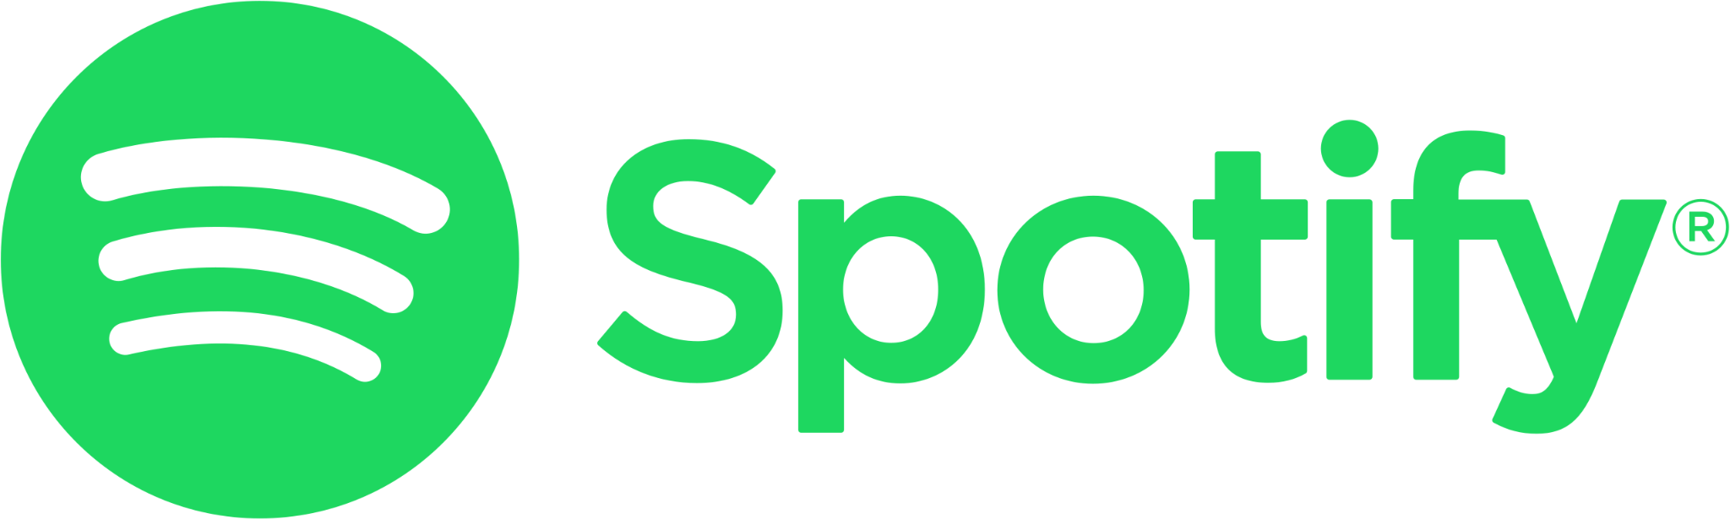
Leveraging Data to
Inhibit Platform Growth
Suhho Lee, Thi Nguyen, Trevor Eaton

Slide 2
Table of Contents
About Spotify
About the Dataset
Spotify and Other Platforms
Inhibiting Platform Growth

Slide 3
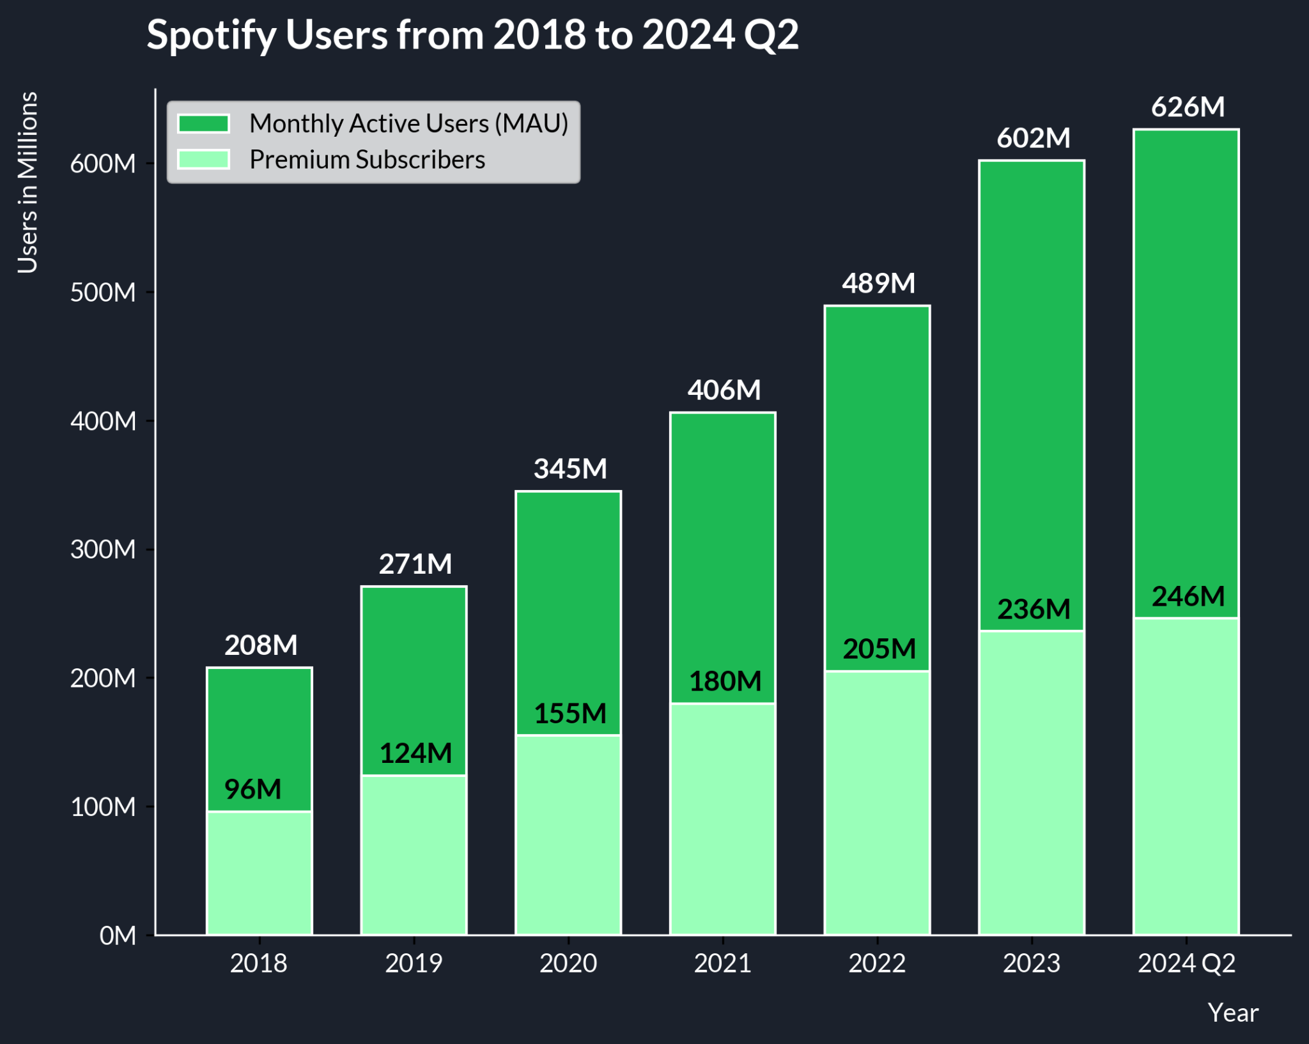
Spotify’s Growth Over the Years
Monthly Active Users (MAU): 626 Million
Premium Subscribers: 246 Million
In 2024, 184 markets (countries) around the world use Spotify.
2021 had the highest increase with 85 new markets entering Spotify.
References
https://newsroom.spotify.com/2021-11-17/spotify-expands-to-six-more-countries-around-the-world/
https://investors.spotify.com/financials/default.aspx

Slide 4
Our Mission Statement
Unlock the potential of human creativity by giving a million creative artists the opportunity to live off their art and billions of fans the opportunity to enjoy and be inspired by it.

Slide 5
Clean-up / Selection
Data Types
Converted all the data that are in numbers into floats
Converted ‘Release Date’ into datetime objects
Added a ‘Release Year’ column from ‘Release Date’
Missing Data
Removed the ‘TIDAL Popularity’ column as all of the data were missing
Replaced other missing data with np.nan so that the values are ignored when computed
Selected Columns
Picked ‘Spotify Streams’ as the main performance data
Removed songs that did not have ‘Spotify Streams’
Dropped unnecessary columns that did not have connections to our analysis

Slide 6
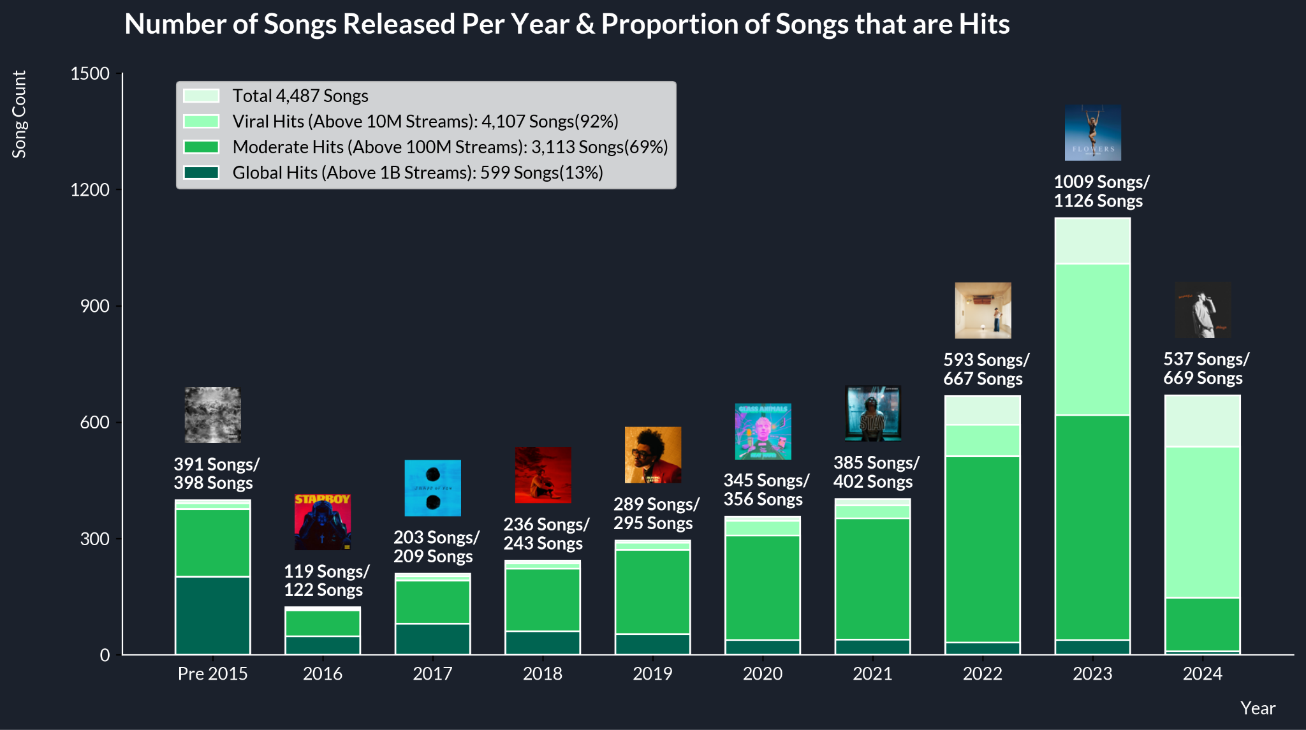
What Songs Are in Our Dataset?
Oldest: Sweet Child O’ Mine - Guns N’ Roses (July 21, 1987)
Newest: The Door - Teddy Swims and 2 other songs (June 14, 2024)
Only 406 songs (8.8%) within the dataset were released before 2015
Most of the songs in this dataset are hits

Slide 7
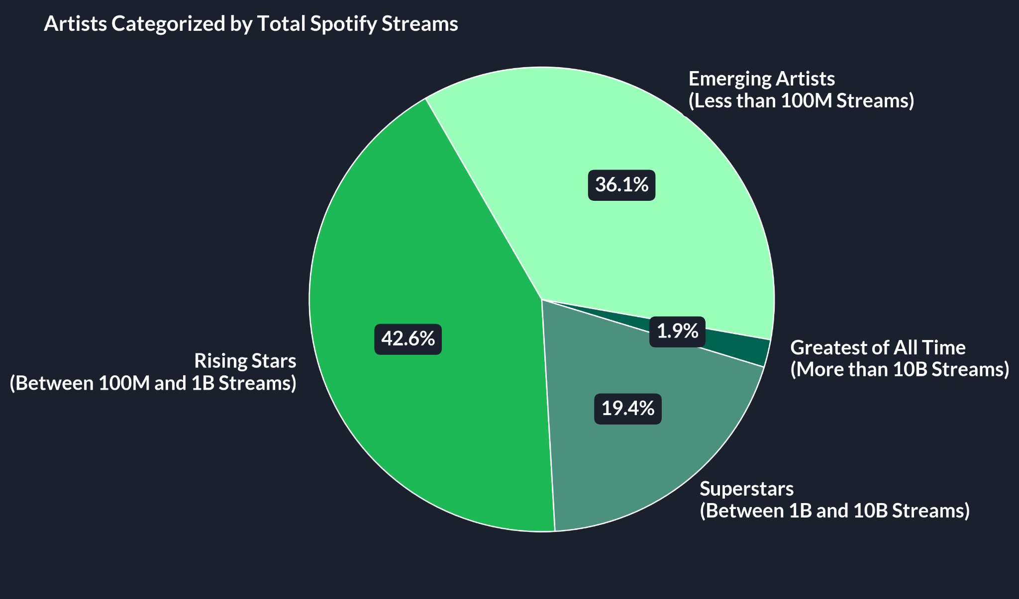
Which Artists are in the Spotify Dataset?
Notes:
How to promote emerging artists and rising stars?
Where the platform is going and push the numbers of these artists?
UNLOCK THE POTENTIAL

Slide 8
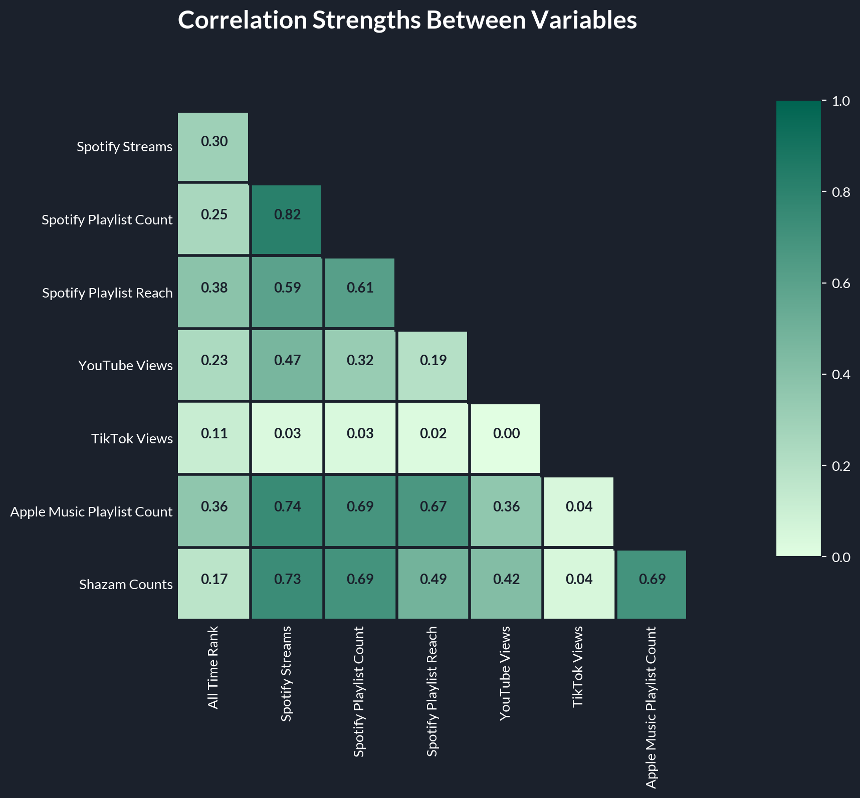
Spotify and other Platforms
TikTok with Spotify Streams: 0.11 (Very Low)
TikTok is effective for initial awareness but doesn't strongly translate to Spotify streaming
Differences in user demographics and engagement behaviors
Cross-Platform Popularity
Platforms: YouTube, Apple Music, Spotify
High cross-platform influence
Tracks popular on one platform tend to be popular on the other
Importance of securing playlist placements across multiple platforms
Notes:
Chose Shazam because:
The idea of Shazam encourages engagement (what is this song???) and has a similar goal as a platform
Obvious correlation
TikTok is used for content creation, so the target audience and ways in which music is used is very different from Spotify’s mission.

Slide 9
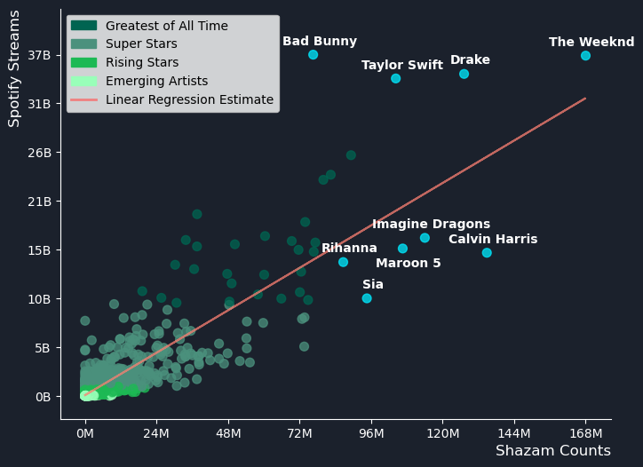
Spotify and Shazam
Artists with the highest Spotify streams tend to also have the highest Shazam counts
Those below the regression line have lower Spotify performance in relation to their success on Shazam
This is especially true for artists like Calvin Harris, Imagine Dragons, and Maroon 5
Notes:
Artists below the line have lower Spotify Streams compared to what their Shazam Counts indicate. This suggests that these artists might have high engagement on Shazam, but their Spotify performance isn’t reflecting that same level of interest. This could imply that they have potential for growth on Spotify, perhaps due to factors like marketing, playlists, or listener habits.

Slide 10
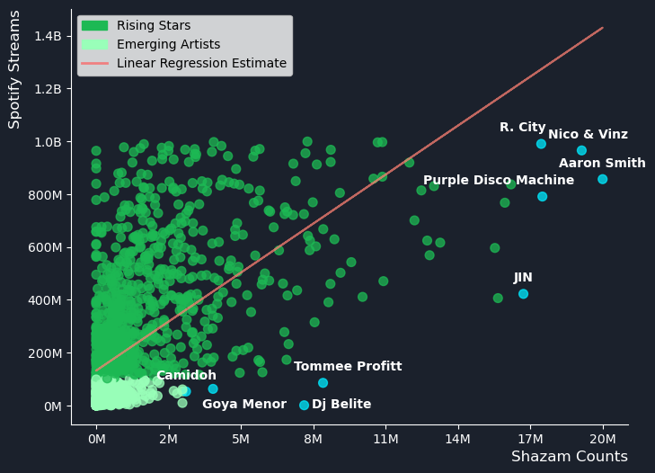
Spotify and Shazam (continued)
These data share a similar pattern to the overall set
We are especially interested in artists that are below the regression line with relatively high Shazam counts
These could be the next stars that help grow our platform
Notes:
Artists below the line have lower Spotify Streams compared to what their Shazam Counts indicate. This suggests that these artists might have high engagement on Shazam, but their Spotify performance isn’t reflecting that same level of interest. This could imply that they have potential for growth on Spotify, perhaps due to factors like marketing, playlists, or listener habits.

Slide 11
What can we learn from these data?
We are observing a clear link between an artist’s exposure through Shazam and how many streams they get on Spotify.
To capitalize on this, Spotify should:
Recommend high-performing Shazam songs on Spotify
Increase their frequency in Spotify playlists and algorithmic recommendations
Promote a more user-friendly experience linking Shazam and Spotify
Add buttons/options to immediately add Shazam’ed songs to a user’s playlist(s)
Invest in the emerging artists and rising stars
Utilize Shazam data to select these artists and promote them on Spotify

Slide 12
Thank you.

